Slide 1

Mastering Air Quality Control

Slide 2

LIST OF COMPONENTS:
ESP32 MICROCONTROLLER
GAS SENSOR(MQ2)
JUMPER WIRES
BREAD BOARD

Slide 3
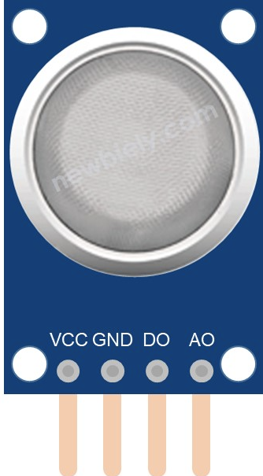
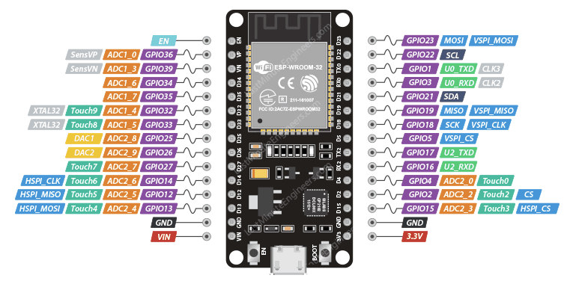
CIRCUIT DIAGRAM:
CONNECT A0-D34

Slide 4
CONNECT GND - GND

Slide 5
CONNECT VCC-3.3V

Slide 6
CODE:
#define MQ2pin 34
float sensorValue;
void setup()
{
Serial.begin(9600);
Serial.println("Gas sensor warming up!");
delay(20000);
}
void loop()
{
sensorValue = analogRead(MQ2pin);
Serial.print("Sensor Value: ");
Serial.print(sensorValue);
if(sensorValue > 200)
{
Serial.print(" | Smoke detected!");
}
Serial.println("");
delay(2000);
}

Slide 7
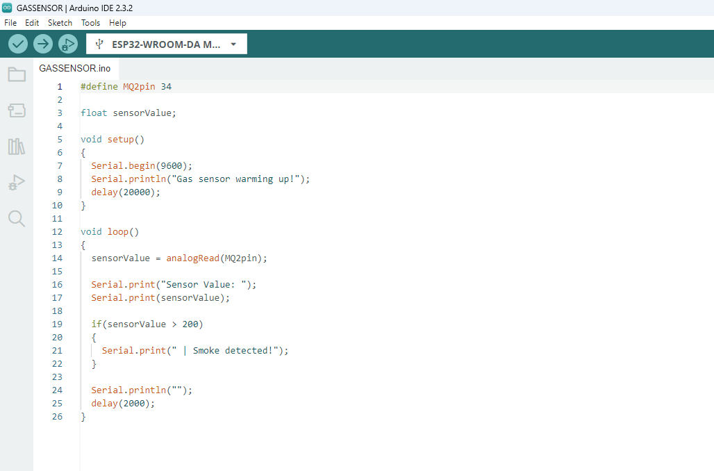
STEP 1:
Copy code paste in Arduino new Sketch

Slide 8
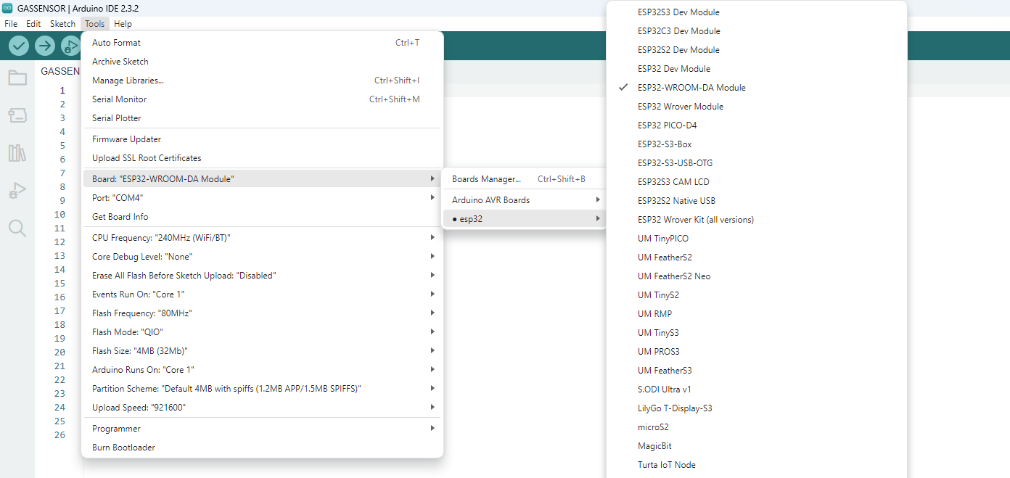
STEP 2:
Board---->esp32---->esp32-wroom-DA module

Slide 9
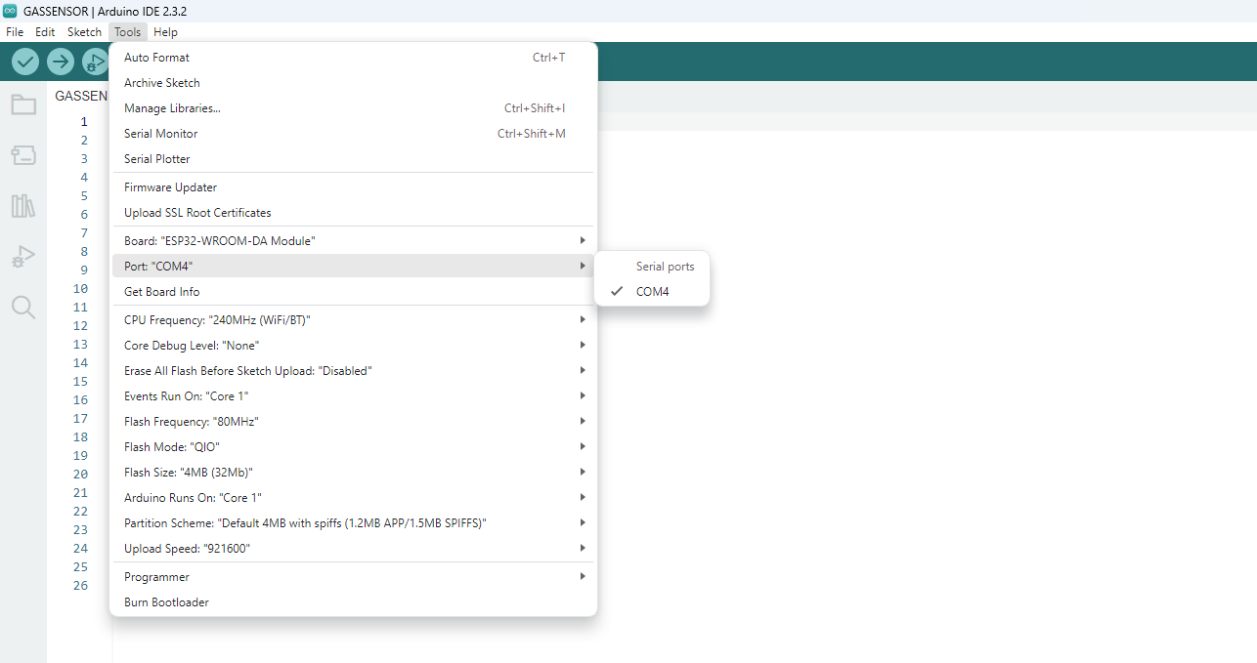
STEP 3:
Tools---->port---->select your com

Slide 10
board name automatically change to dark

Slide 11
2.After Compilation build the code to board
1.Compile the code

Slide 12
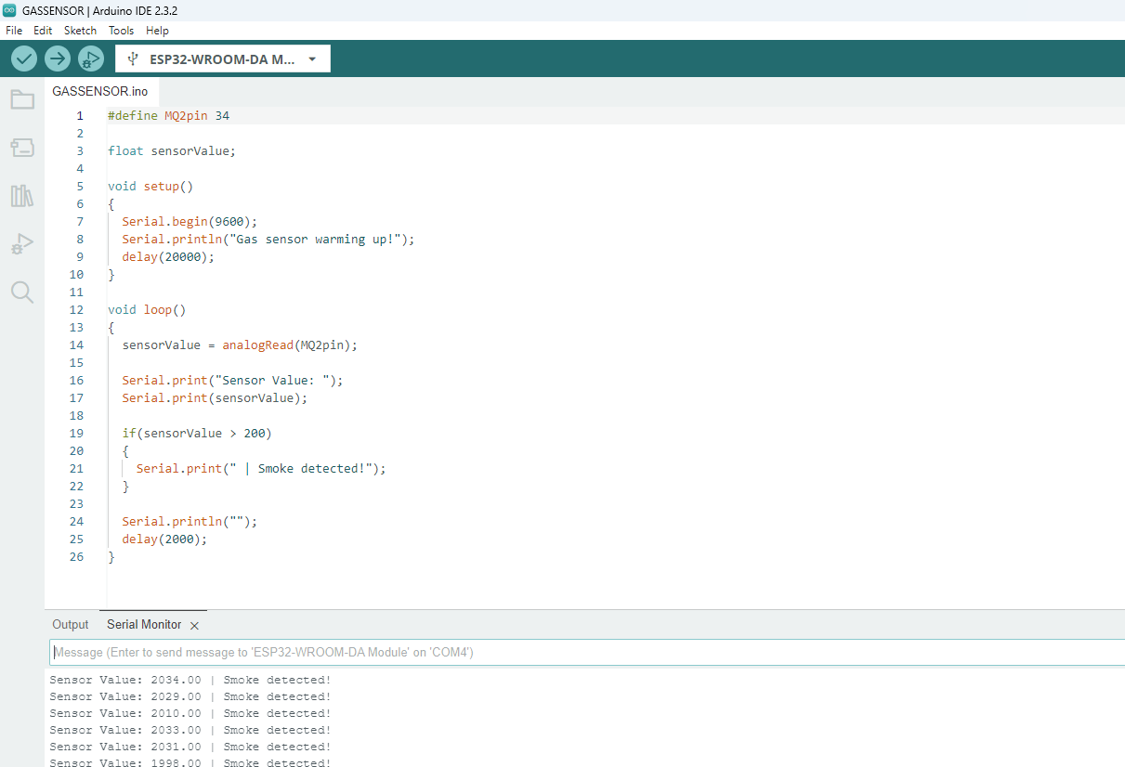
OUTPUT:
After Build the code the output like this

